Slide 1

Lecture 5 Collecting Data Using Electronic Data Loggers and Environmental Sensors
Jeffery S. Horsburgh
Hydroinformatics
Fall 2016
This work was funded by National Science Foundation Grants EPS 1135482 and EPS 1208732

Slide 2
Announcements
Assignment 1 due on Thursday
Bring your Arduino kits on Thursday – look for a Canvas announcement about software installation, etc.

Slide 3
Objectives
Learn basic data collection concepts for hydrologic data
Examine more closely observation dimensionality, including the scale triplet of support, spacing, and extent
Learn the basic datalogger program structure for logging data

Slide 4
Why do we measure the hydrologic environment?
Detect illegal discharges
Optimize efficiency of water
treatment
Assessing impact of change
Early warning for natural disasters
Better understand and predict
natural processes
Reduce health risks for
water consumers
Determine compliance with
water quality standards
Detect and quantify
Environmental change

Slide 5
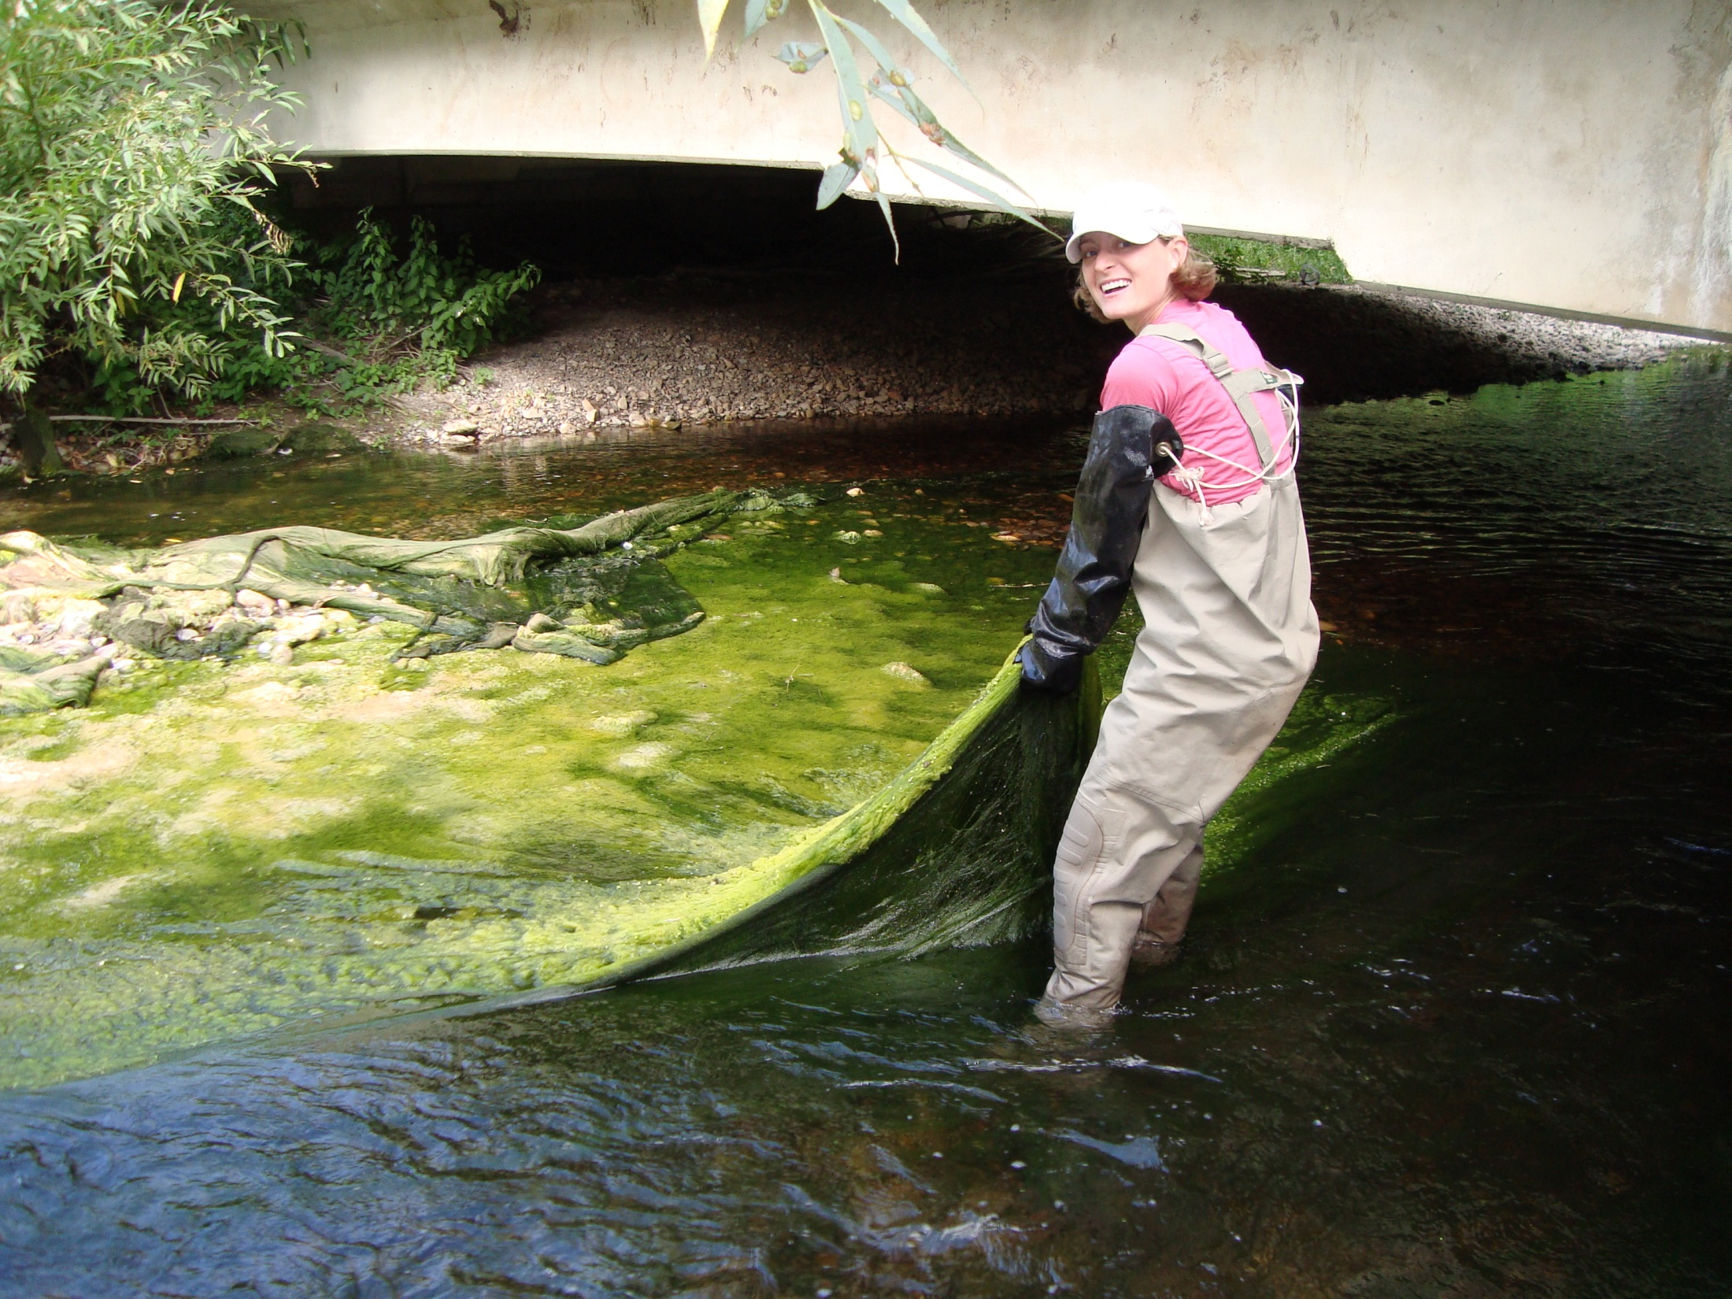
Little Bear River, Utah
Water Quality Issues
Nutrients (Primarily P)
Sediment

Slide 6
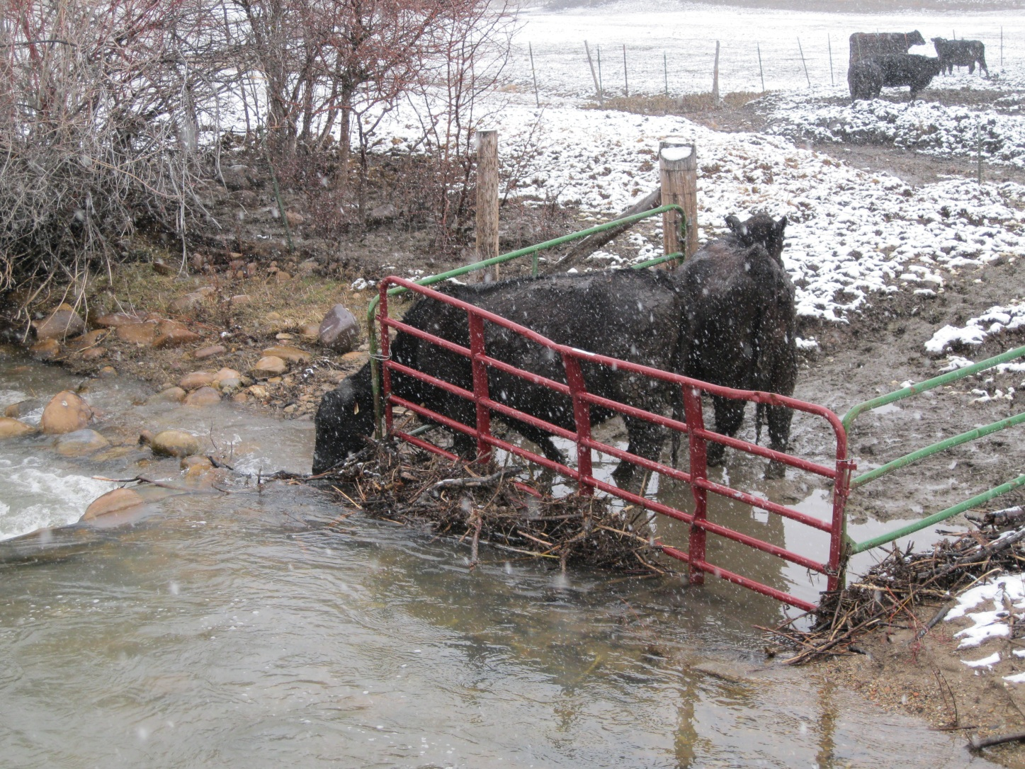
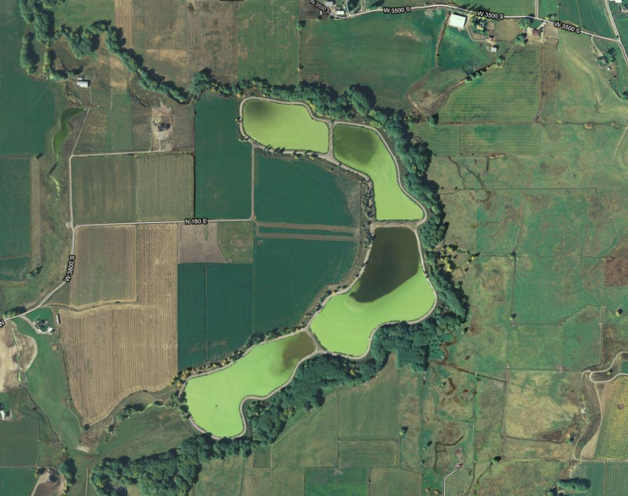
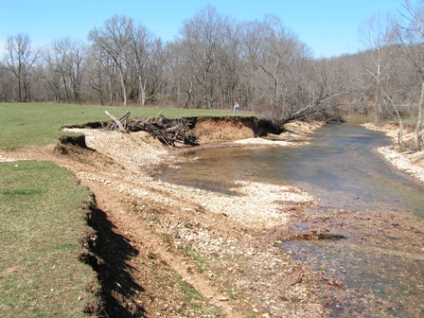
Little Bear River
Pollution Sources: Agriculture Wastewater Treatment
Notes:
P sources include fertilized fields, animal waste, WWTP and p-rich soils

Slide 7
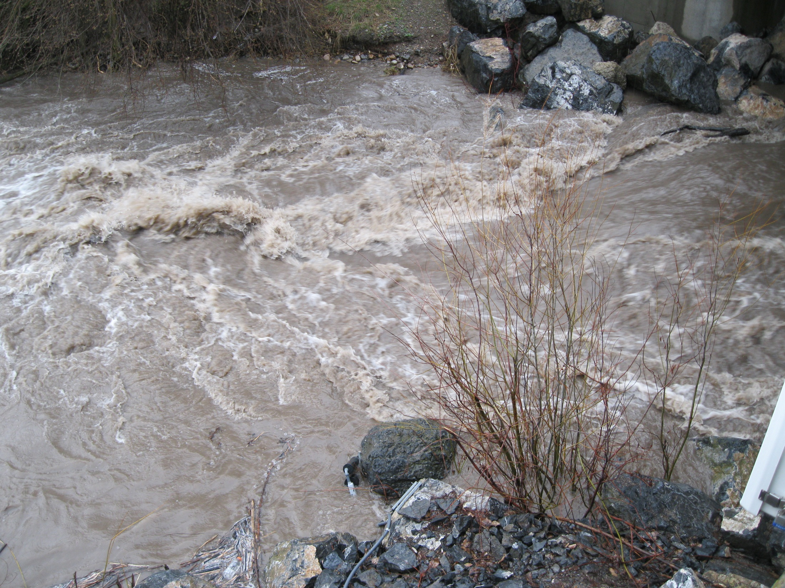
Some Interesting Questions
How do water quality conditions vary throughout a watershed?
What processes (human and natural) drive the variability?
How and why does WQ change over time (minutes - years)
Are WQ conditions getting better or worse?
What might happen in the future?

Slide 8
What We Really Want
Continuous records of hydrologic variables enable us to observe:
Timing and magnitude of hydrologic events and constituent fluxes
What happens from one point in a watershed to the next
Conditions that drive hydrology (e.g., precipitation, soil moisture, groundwater levels, snow depth and water equivalent…)

Slide 9
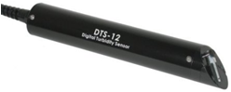

Water Sensors
YSI exo multiparameter sonde
Temperature
Dissolved Oxygen
pH
Specific conductance
fDOM
Bluegreen algae
…
Forest Technology Systems DTS-12 Digital Turbidity Sensor
Turbidity
Temperature
Campbell Scientific CS-450 Pressure Transducer
Water level
Temperature

Slide 10
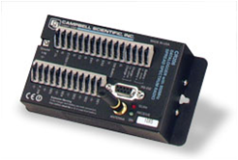
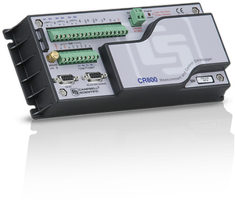
Dataloggers
Campbell Scientific
CR206
CR800
A variety of measurement types
Analog
Digital
CRBasic programming language
Table based

Slide 11
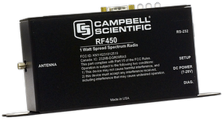
Telemetry
900 MHz Spread Spectrum Radios
Cellular phone modems
Satellite systems

Slide 12
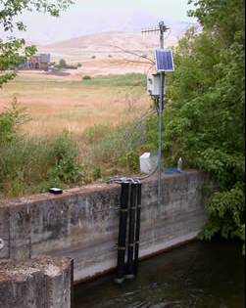
A Typical Site
Radio antenna
Solar panel
Instrument enclosure
Sensor housings

Slide 13
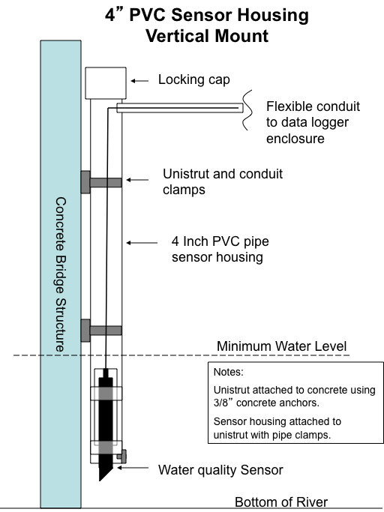
Sensor Housings
Permanently mounted to bridge structures
Protect sensors from debris/vandalism

Slide 14
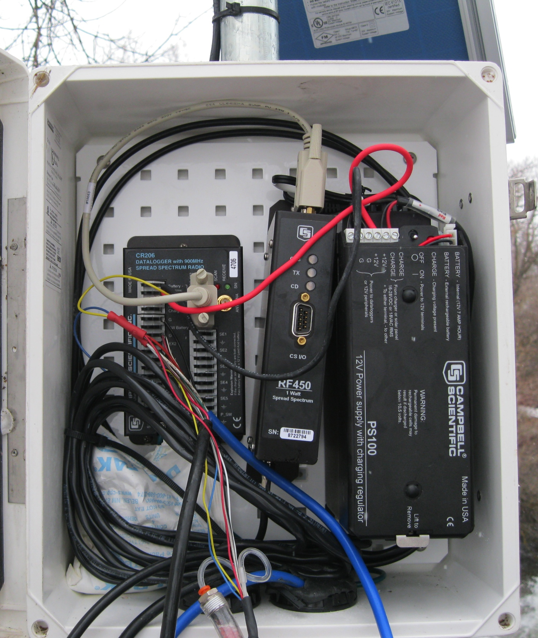
Instrument Enclosure
Radio
Datalogger
Power supply and charge regulator

Slide 15
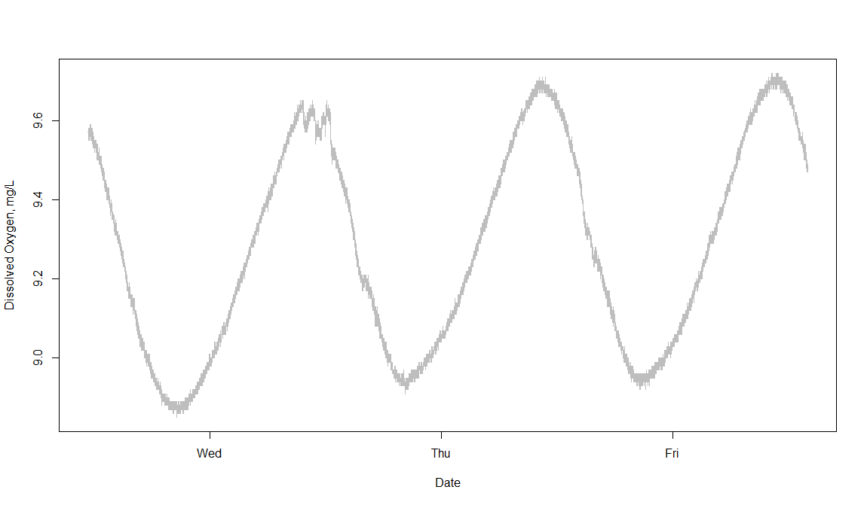
This is all great, but…
How do I go from here…
…to here…

Slide 16
Scale Issues in Collection and Interpretation of Measurements
The Scale Triplet of Measurements
Adapted from: Blöschl (1996)

Slide 17
Issues in Data Collection and Interpretation
Spacing too large – aliasing
*Scan interval too long
Adapted from: Blöschl (1996)

Slide 18
Issues in Data Collection and Interpretation
Extent too small – trend
*Deploy sensors longer…
Adapted from: Blöschl (1996)

Slide 19
Issues in Data Collection and Interpretation
Support too large – smoothing
*Data recording/aggregation interval too long
Adapted from: Blöschl (1996)

Slide 20
Which Sampling Frequency is Correct?
The answer is – it depends on what question you are trying to answer
Consider these two questions:
What is the diurnal pattern of dissolved oxygen concentration in the Logan River?
What is the effect of cloud cover on photosynthesis and dissolved oxygen concentrations in the Logan River?

Slide 21
What is the diurnal pattern of dissolved oxygen concentration in the Logan River?
What would you measure?
How often?

Slide 22
Logan River Dissolved Oxygen Example Raw data – 1 observation per second

Slide 23
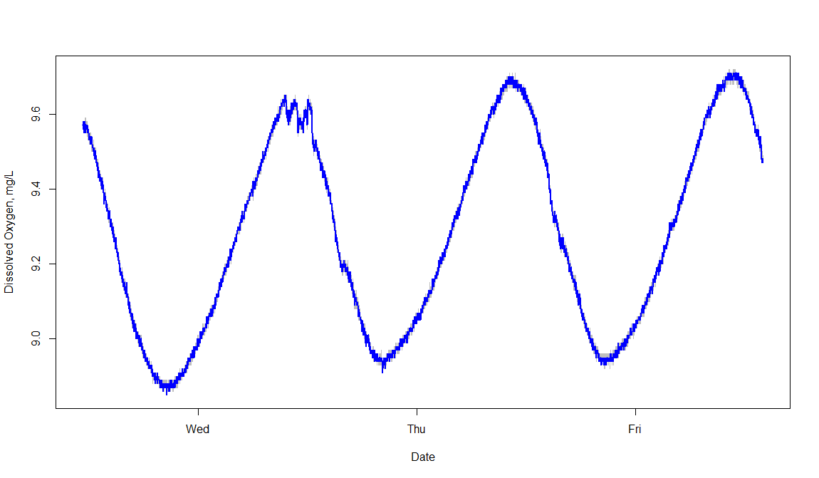
Logan River Dissolved Oxygen Example 1 observation per minute

Slide 24
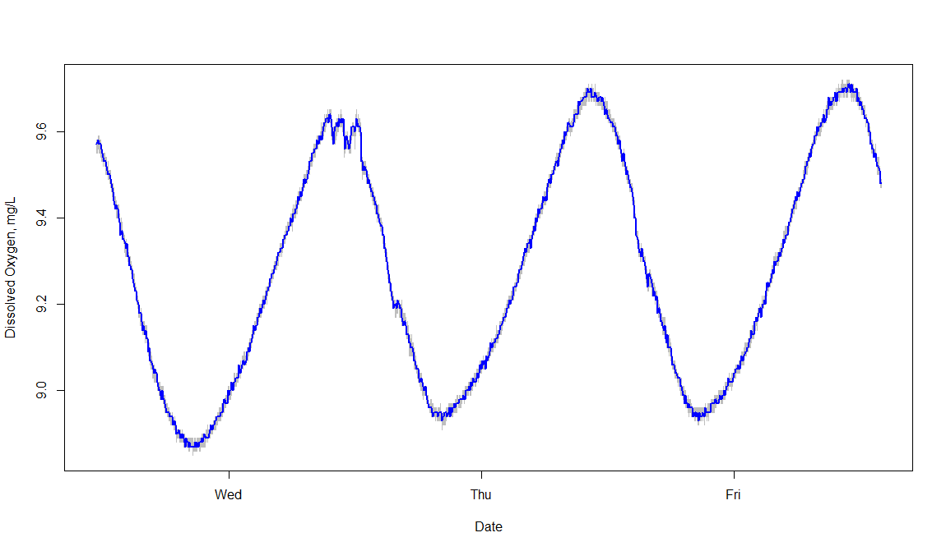
Logan River Dissolved Oxygen Example 1 observation every 5 minutes

Slide 25
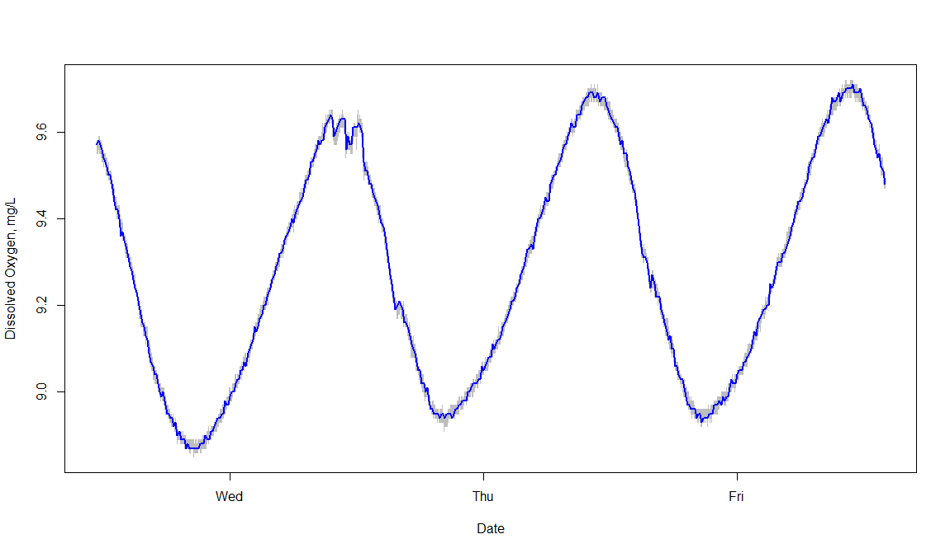
Logan River Dissolved Oxygen Example 1 observation every 10 minutes

Slide 26
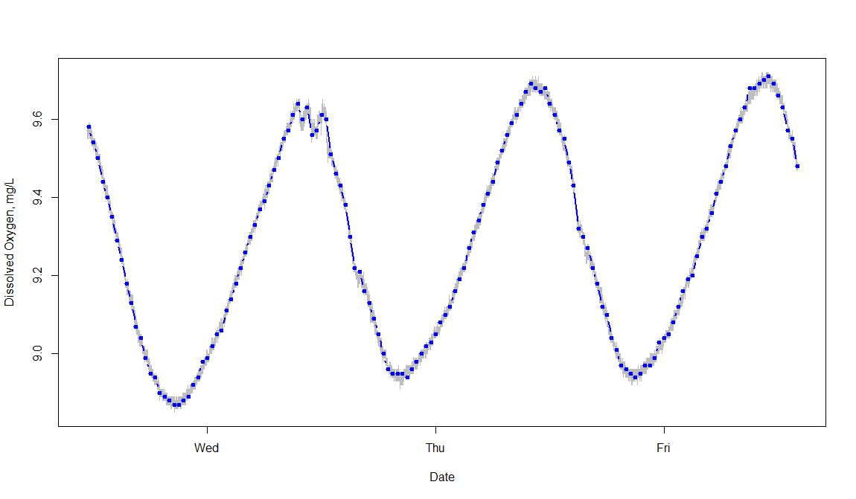
Logan River Dissolved Oxygen Example 1 observation every 30 minutes

Slide 27
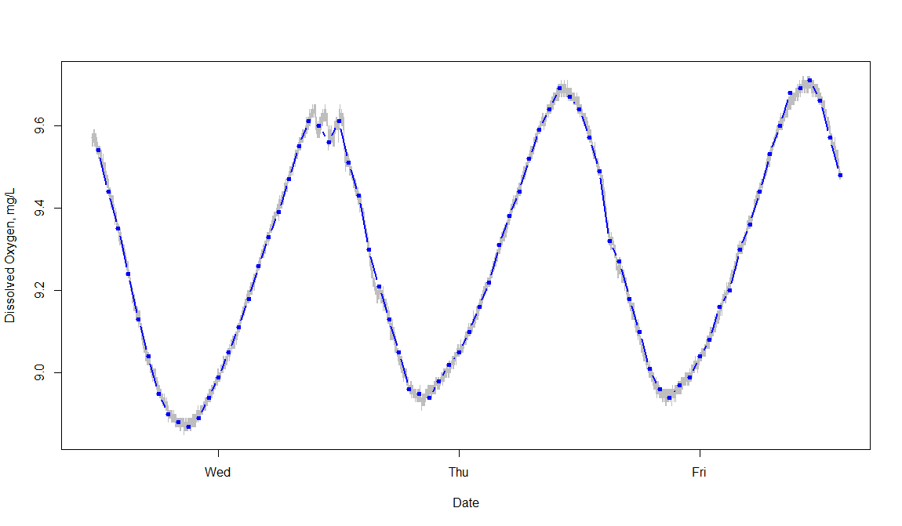
Logan River Dissolved Oxygen Example 1 observation every hour

Slide 28
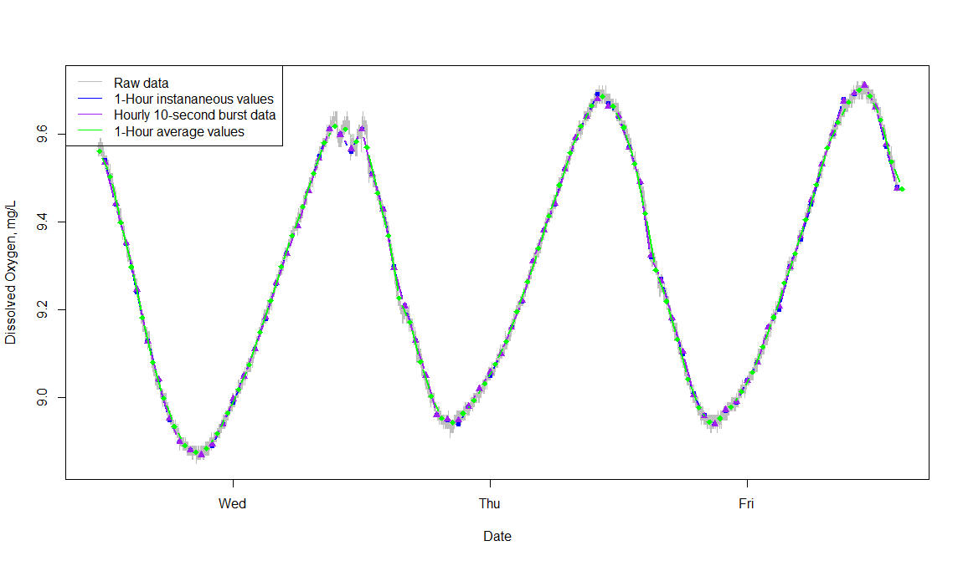
Little Bear River Dissolved Oxygen Example Hourly Observations

Slide 29
What is the diurnal pattern of dissolved oxygen concentration in the Logan River?
1-Hz data (1 observation per second) capture the signal, but show sensor noise
1 min, 5 min, 10 min data are all pretty similar
30 min and even hourly data (in all incarnations) are likely adequate

Slide 30
What is the effect of cloud cover on photosynthesis and dissolved oxygen concentrations in the Logan River?
What would you measure?
How often?

Slide 31
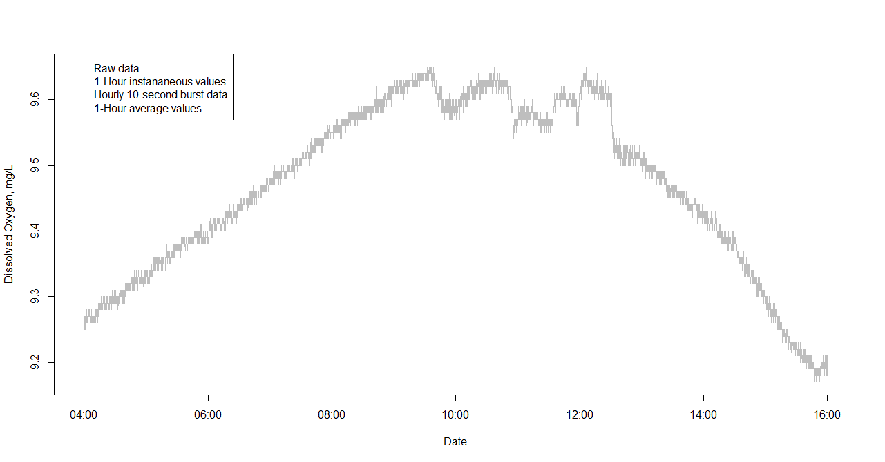
Logan River Dissolved Oxygen Example Raw Data – 1 observation per second

Slide 32
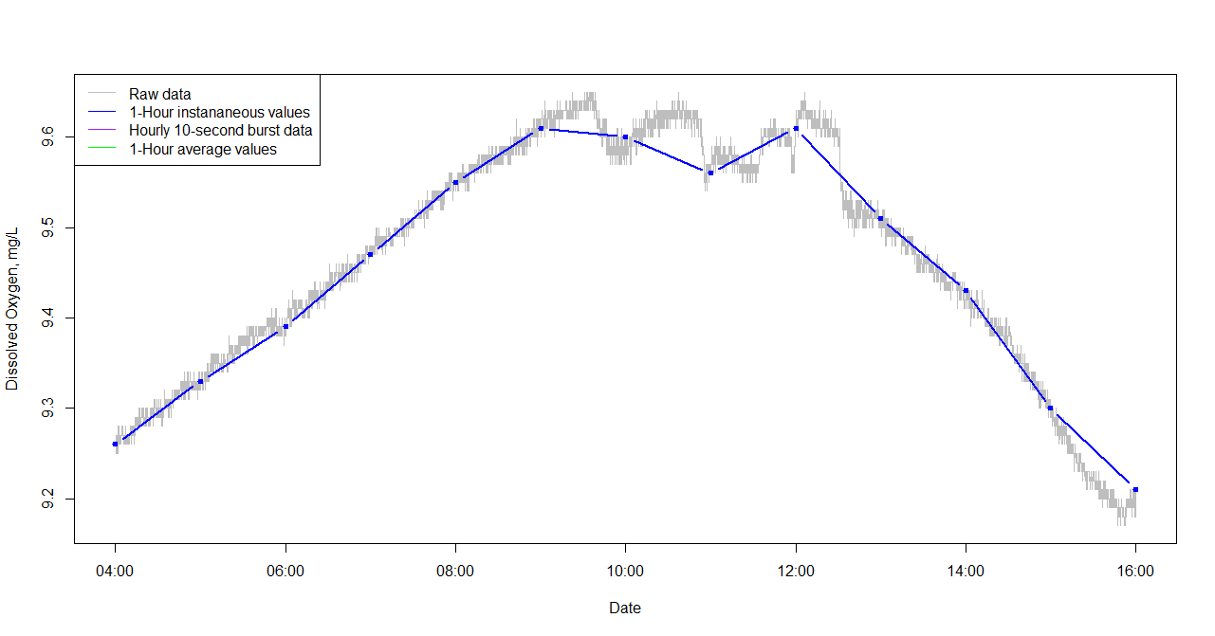
Logan River Dissolved Oxygen Example Raw Data + Hourly Instantaneous Data

Slide 33
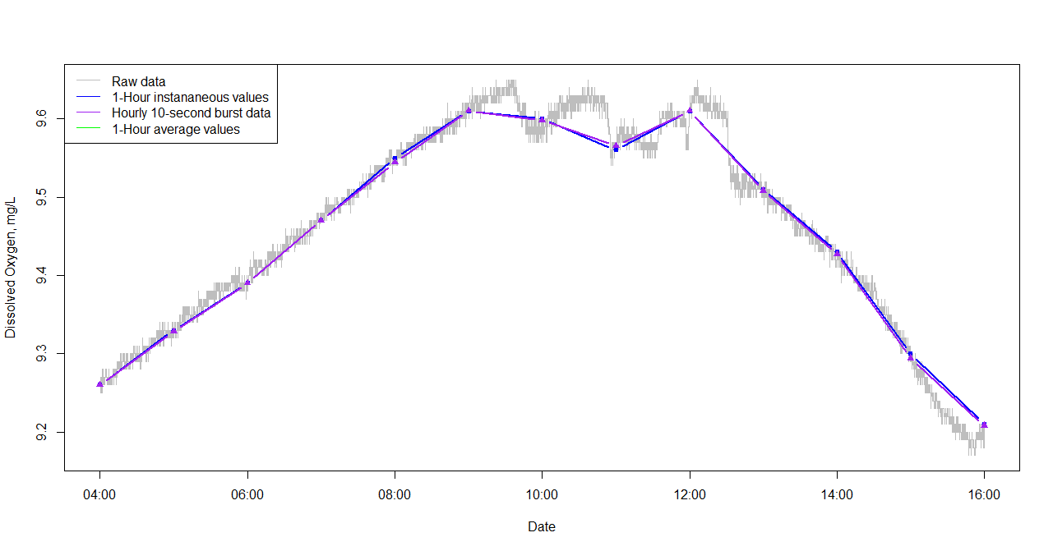
Logan River Dissolved Oxygen Example Raw Data + Hourly Data + Hourly Burst

Slide 34
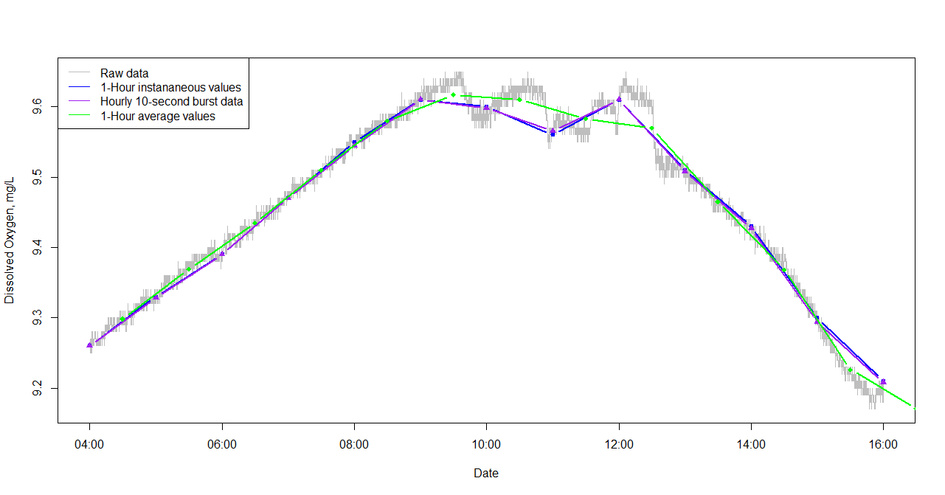
Logan River Dissolved Oxygen Example Raw Data + Hourly Data + Hourly Burst + Hourly Average

Slide 35
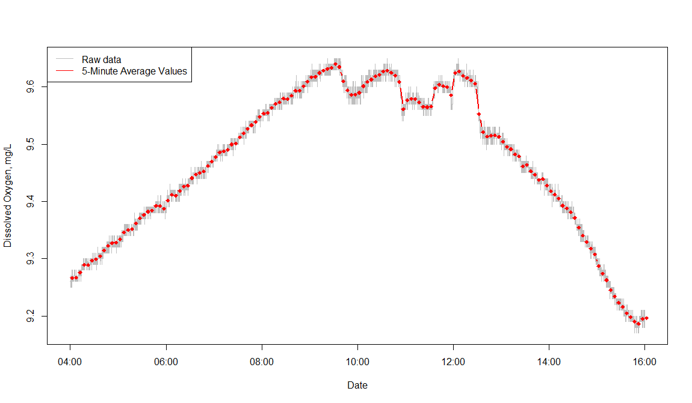
Logan River Dissolved Oxygen Example Raw Data + 5 minute average data

Slide 36
What is the effect of cloud cover on photosynthesis and dissolved oxygen concentrations in the Logan River?
The raw data capture the signal, but still exhibit noise from the sensor
Hourly data are not frequent enough to resolve the time scale of the changes
5 min averages look promising for capturing signal and smoothing sensor noise

Slide 37
The Tradeoffs
High frequency observations
High temporal resolution of measured variable
Large volumes of data created
High power requirements
High communication bandwidth required
May be limited by instrument response time
Lower frequency observations
Efficiency in storage and power
Lost temporal resolution
Cannot subsample
May not be representative (due to aliasing or smoothing)

Slide 38
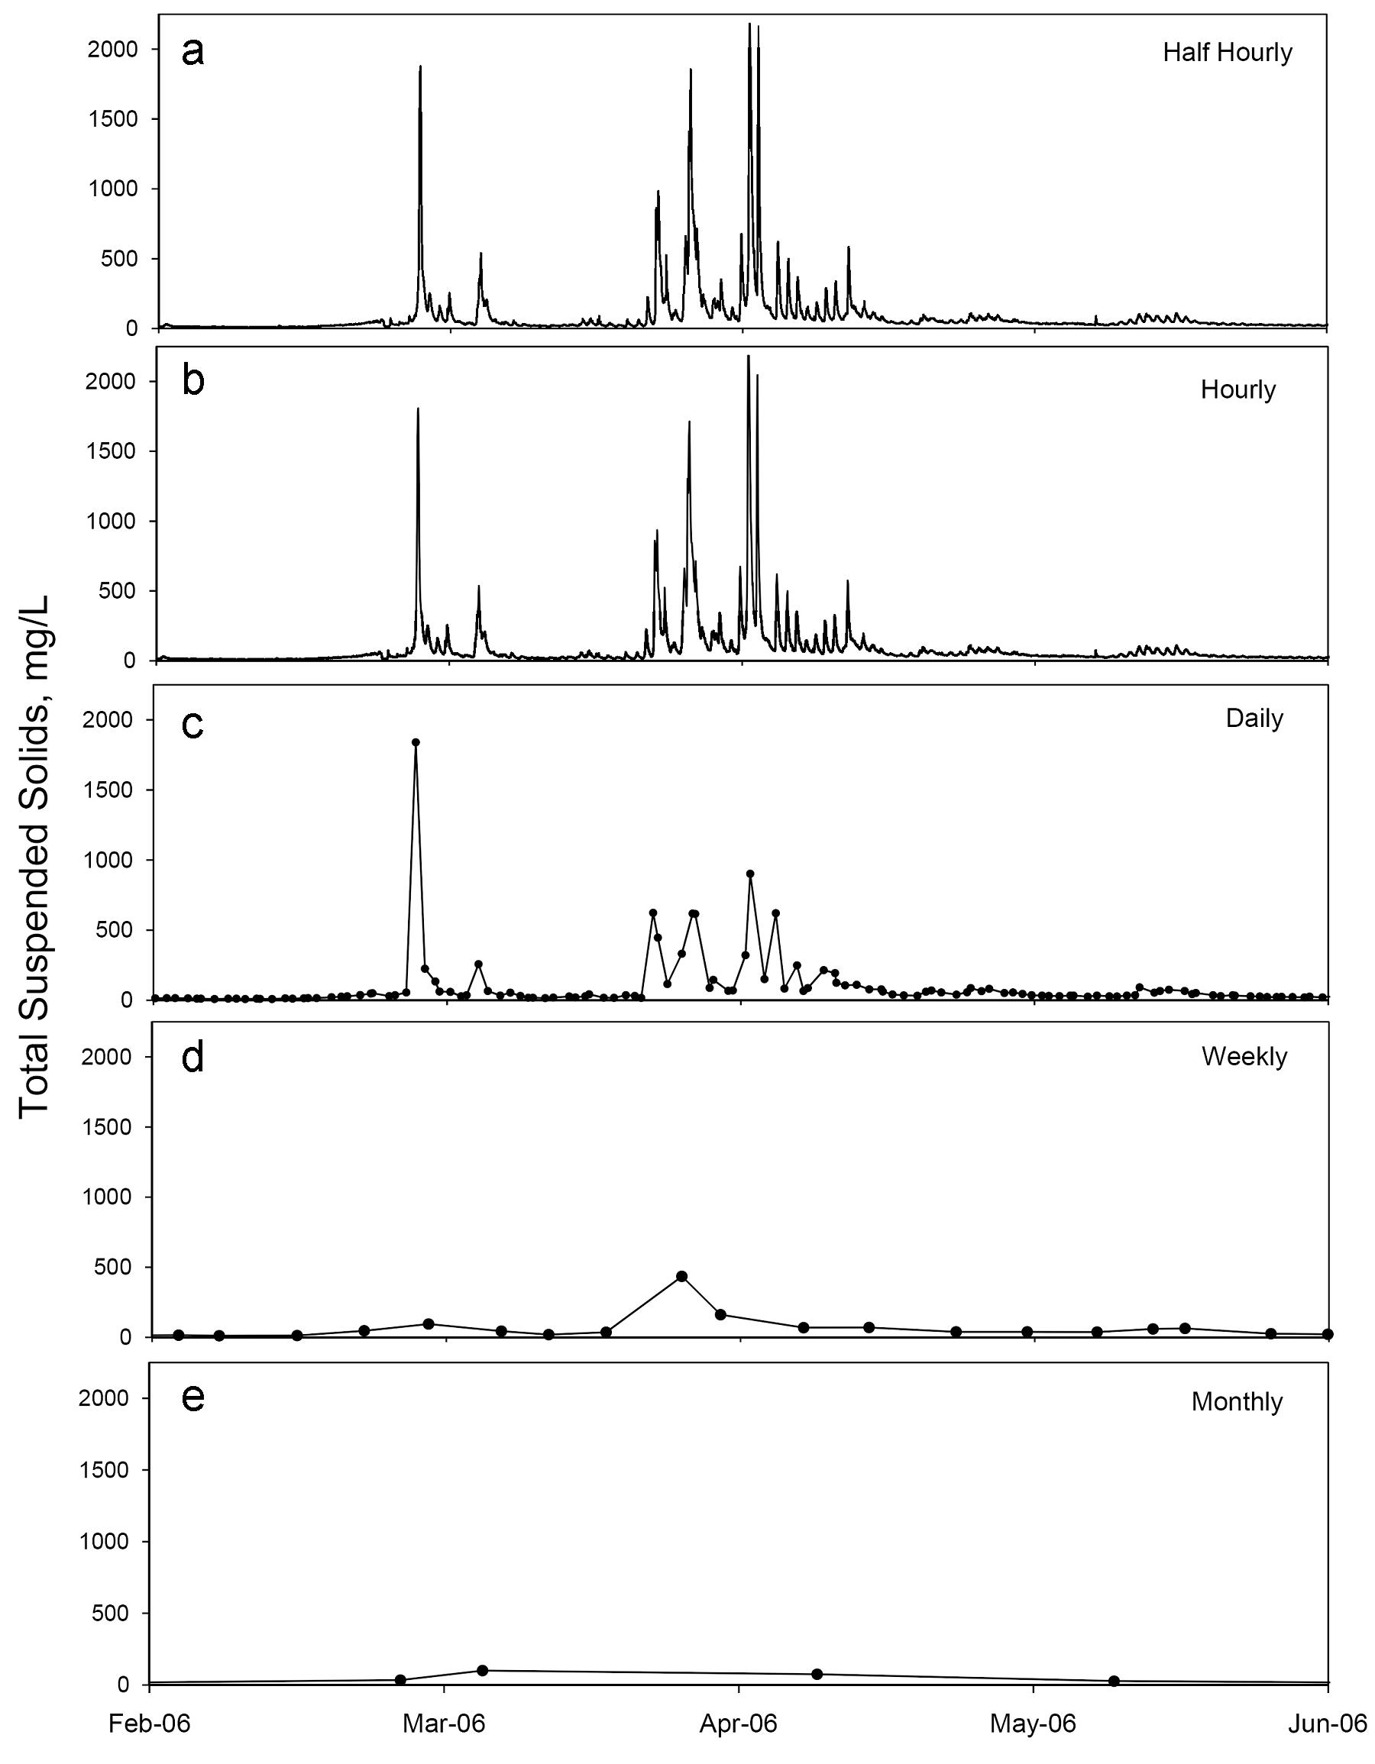
Sampling Frequency
Half hourly
Half hourly data subsampled
-Hourly
-Daily
-Weekly
-Monthly
Hourly
Daily
Weekly
Monthly
Notes:
Plots show effect of sampling frequency:
Hourly- still relatively frequent, little information lost.
Daily- general trend and some peaks captured, but fine resolution data lost.
Weekly and Monthly- completely misses the peaks in concentration, periods of greatest contribution to load.
Randomized sampling conducted 10,000 times in order to achieve a distribution of load estimates.
Daily by hour and weekly by day sampling conducted to examine the timing of sampling collection.

Slide 39
Environmental Sensors
Purpose is to detect events or changes in the environment and provide a corresponding output – usually electrical or optical
Signal is interpreted by or transmitted to a datalogger
Analog
A continuous voltage output proportional to the value of the observed variable
Datalogger must interpret the result
Digital
Sensor does all signal processing
Reports a result encoded as a digital signal to the datalogger

Slide 40
Dataloggers
Electronic device that records data over time from instruments and sensors
Generally programmable
May use integrated or external sensors
Huge variety available commercially

Slide 41
Datalogger Programming
Instructions for how and when to:
Make measurements
Perform calculations
Process data
Communicate data and/or instructions (in more advanced applications)
Encoding instructions to collect observations with the correct support, spacing, and extent to answer your scientific questions…

Slide 42
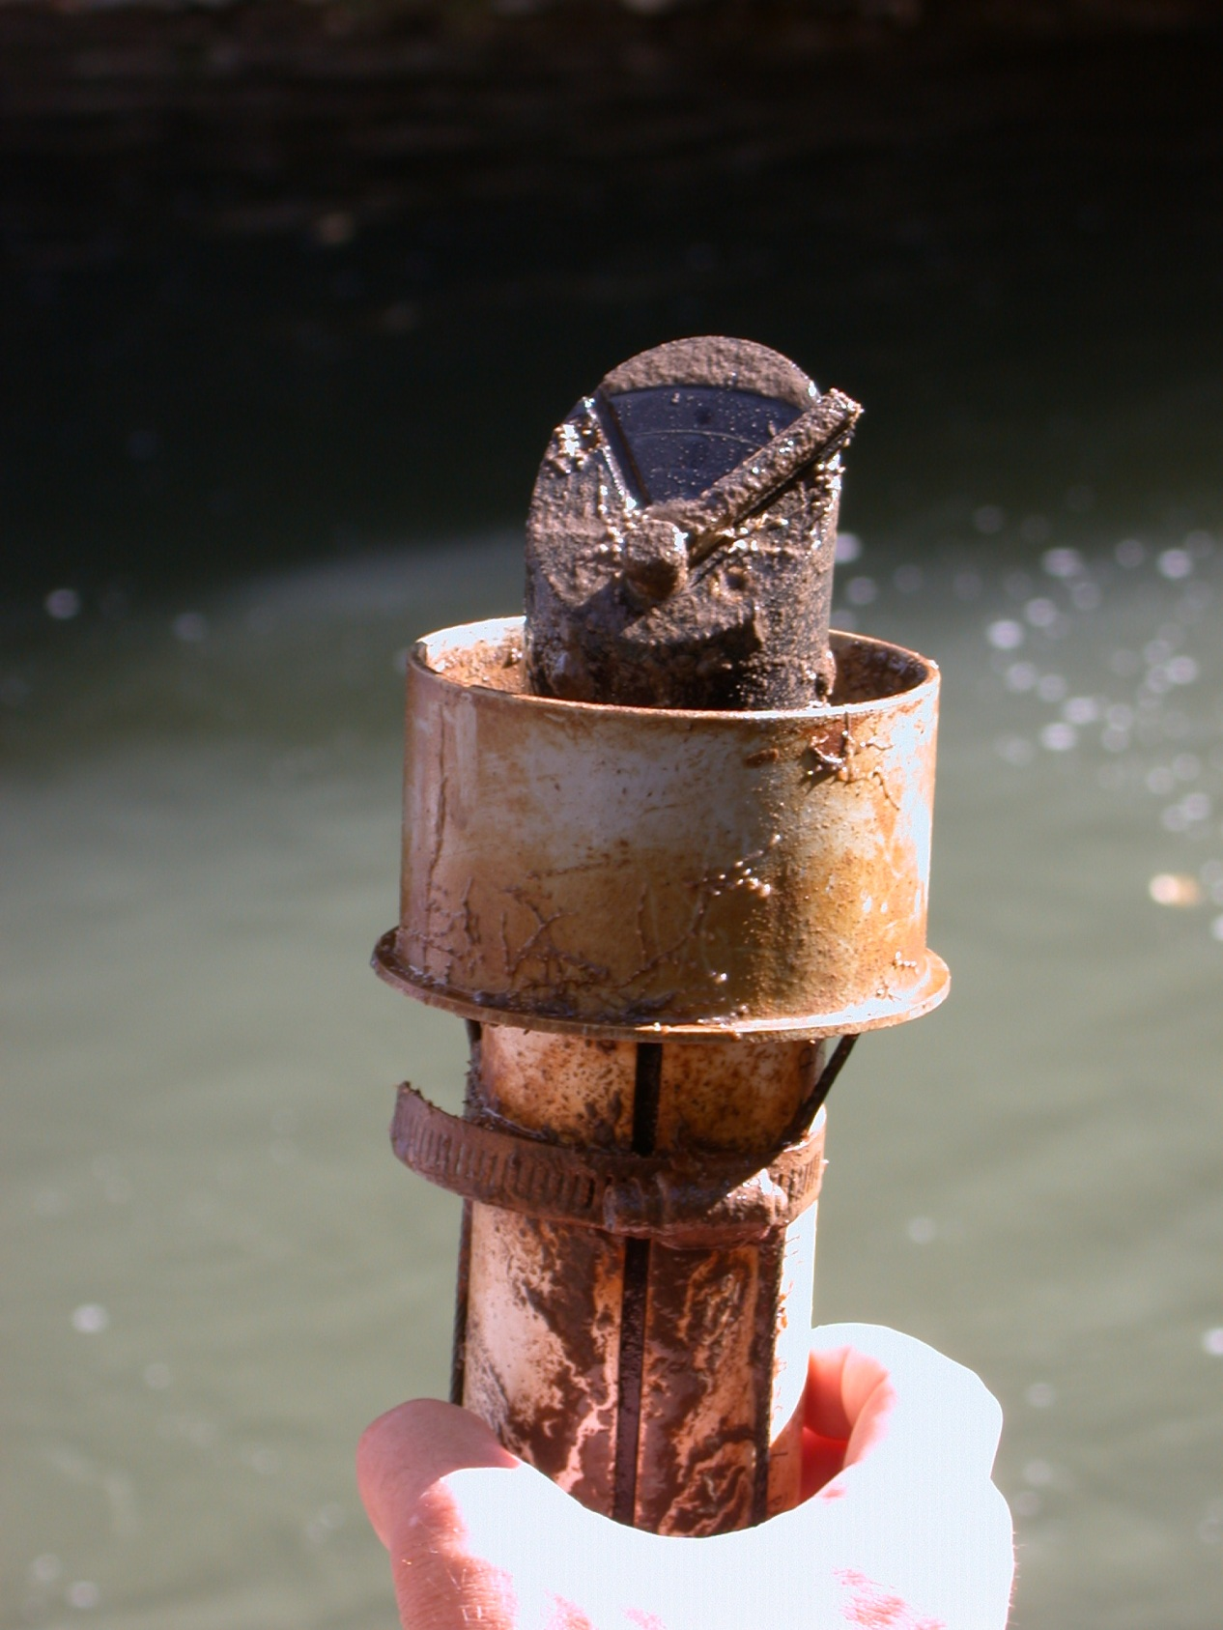
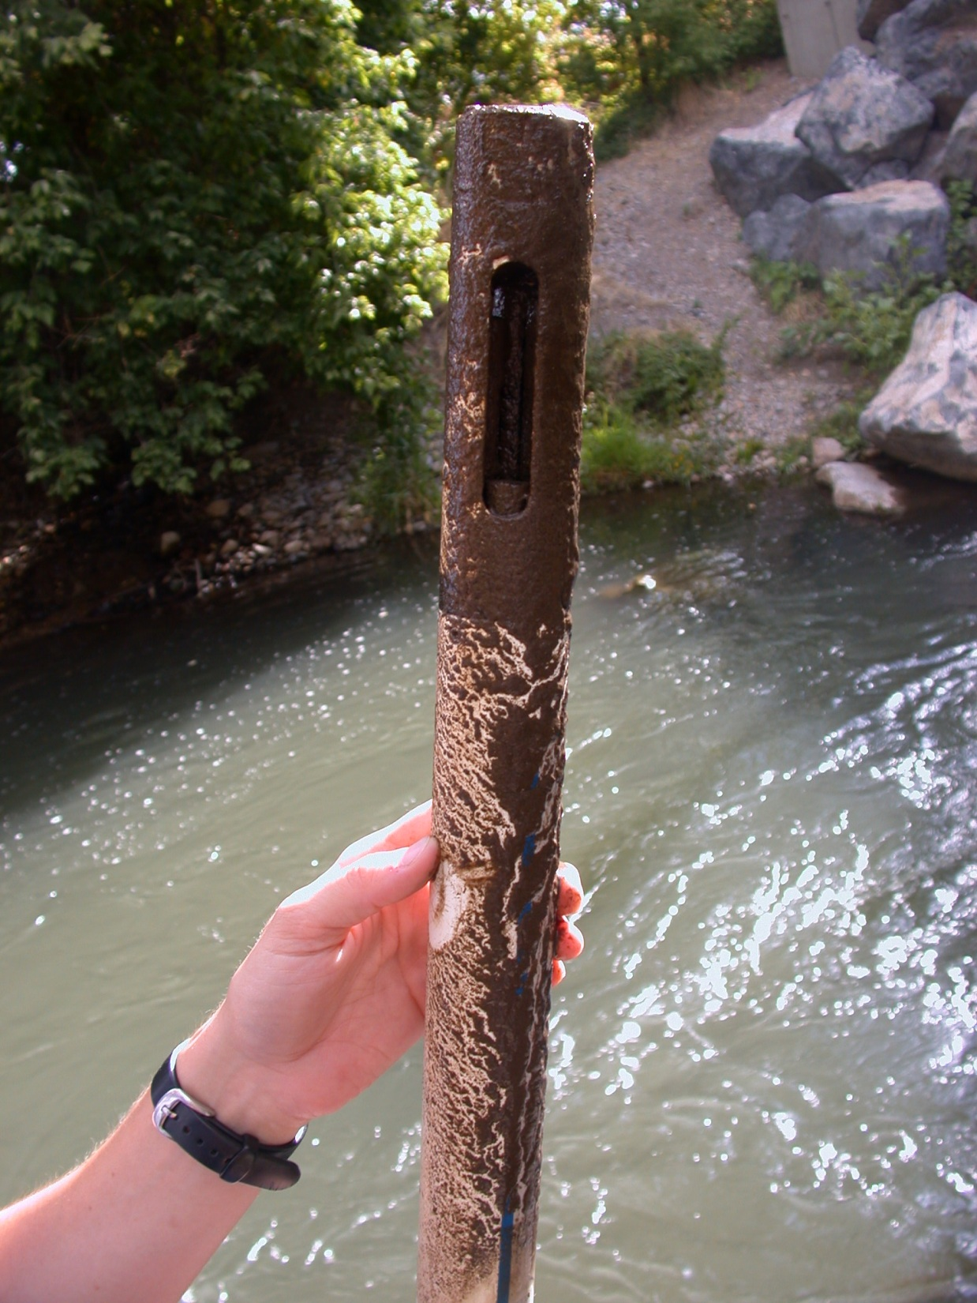
Challenges and Adventures in Continuous Monitoring

Slide 43
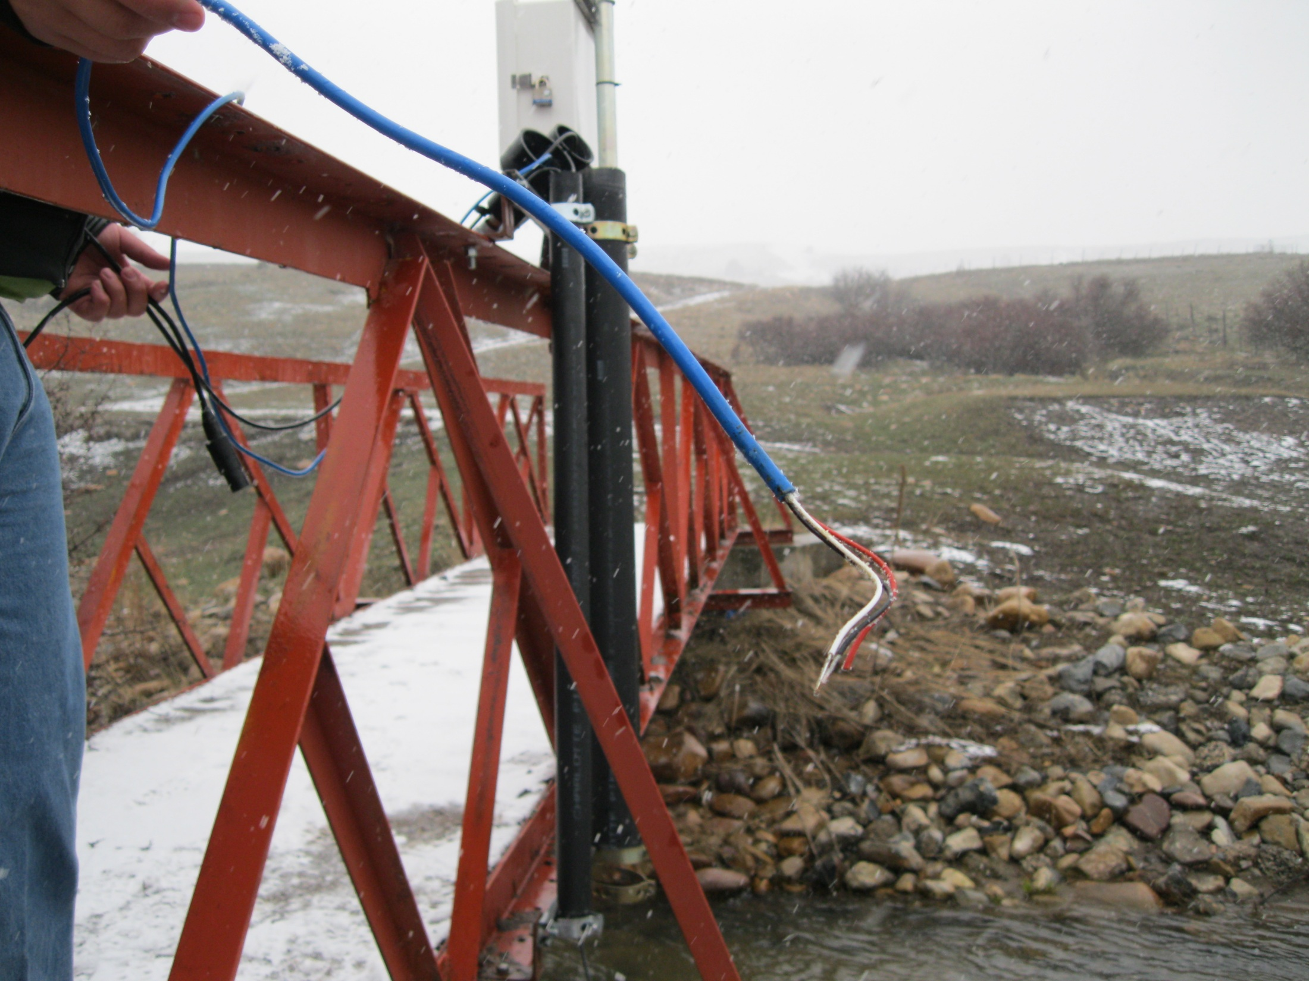
Have you seen my turbidity sensor?
It used to be right here!

Slide 44
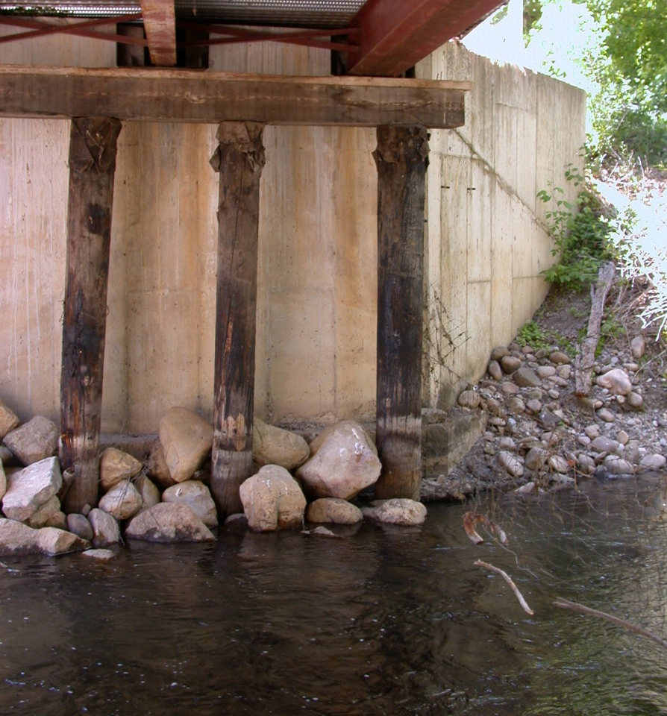
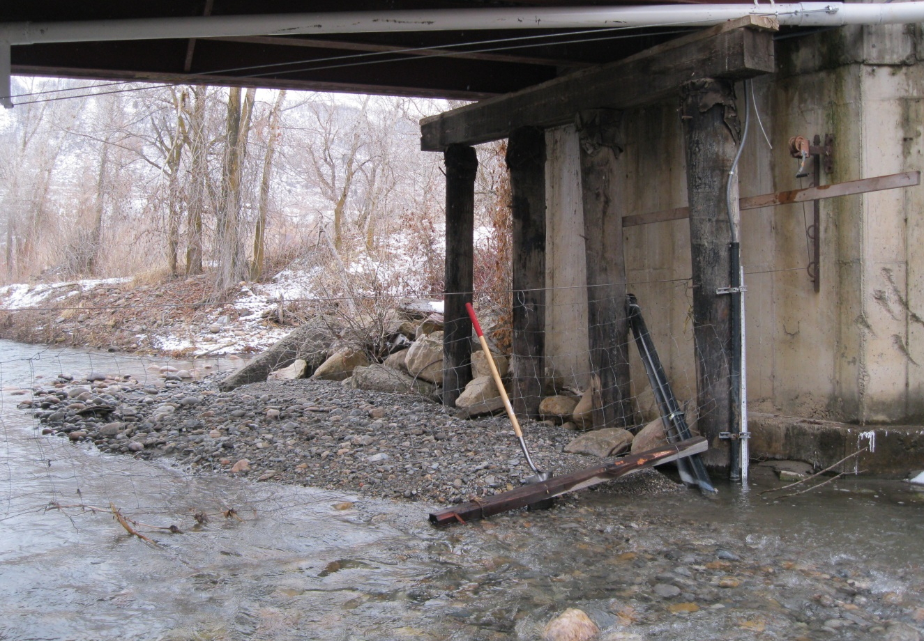
Before
After

Slide 45
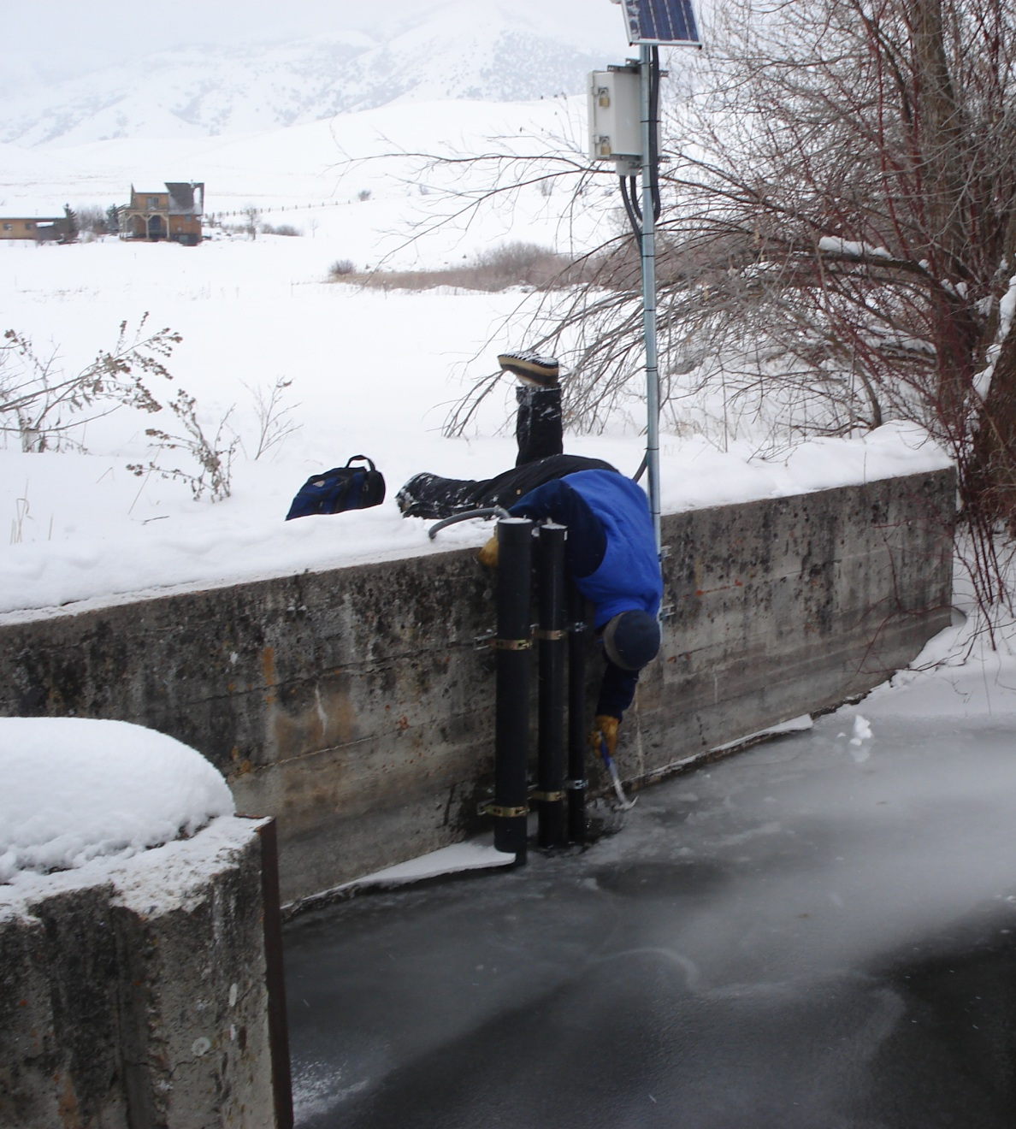
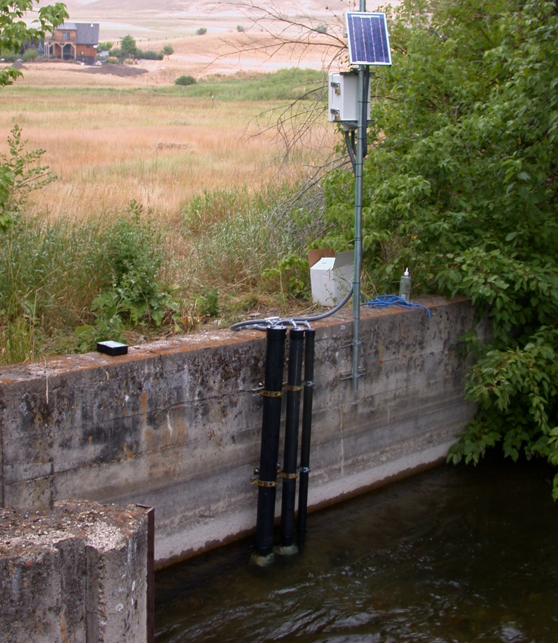

Slide 46
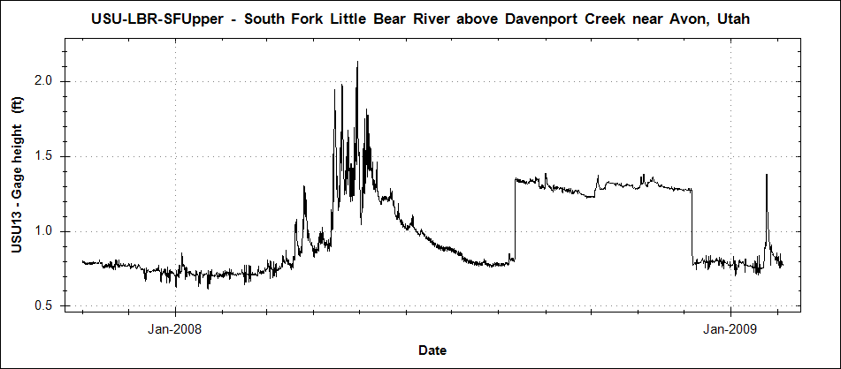
Human Challenges
Farmer drives backhoe into river on neighbor’s property and builds dam for his diversion structure.
Lawyers get involved. Farmer pays for new diversion structure and removes dam.

Slide 47
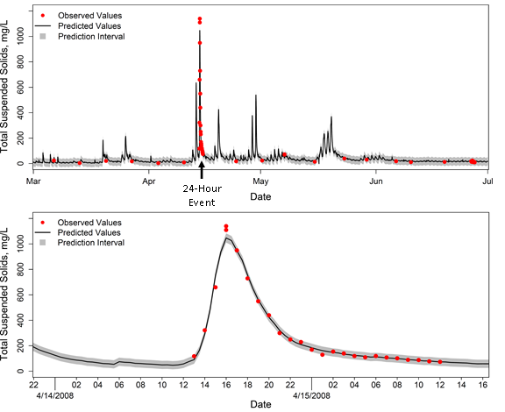
Variability on the Scale of Hours

Slide 48
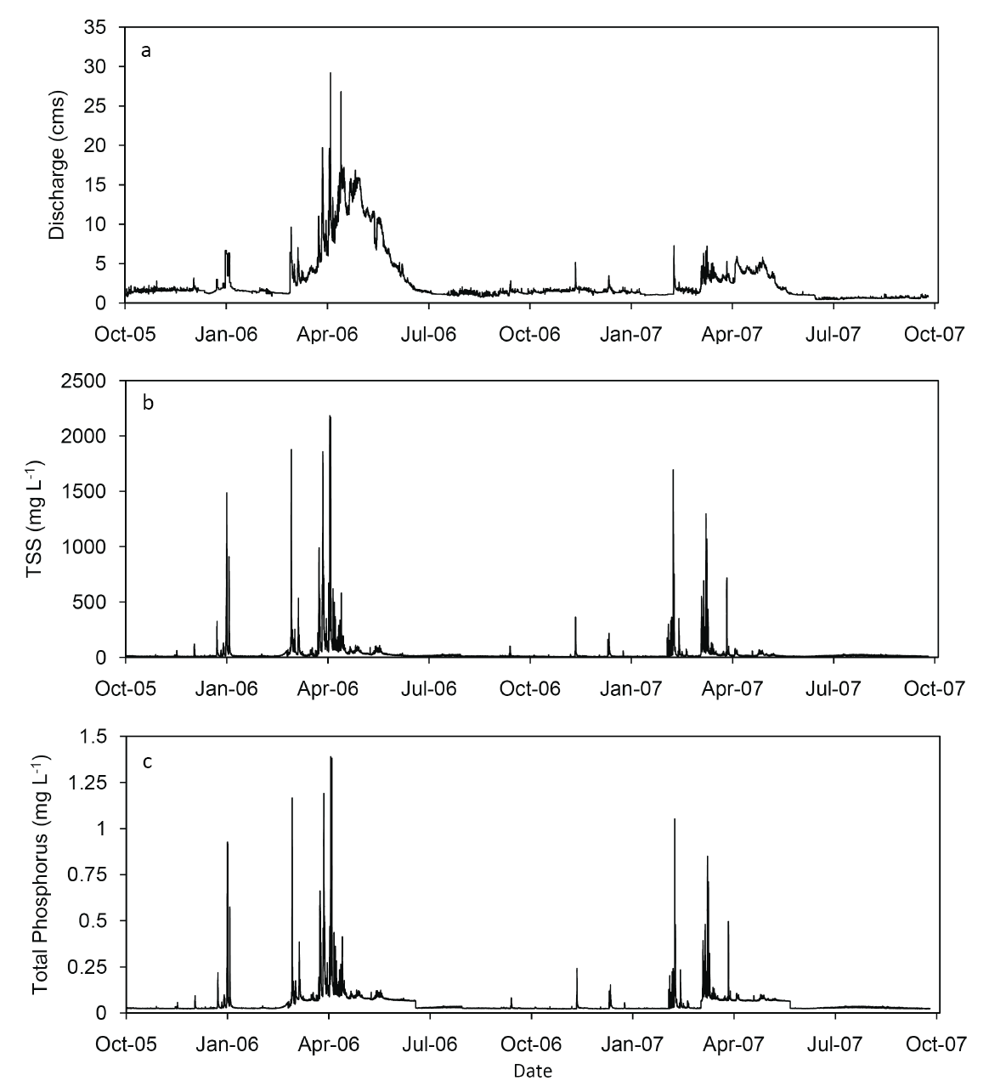
Variability Across Water Years
2007 vs. 2006
~ 45% water volume
~ 20% TSS mass
~ 25% TP mass
Paradise site, water years 2006 and 2007

Slide 49
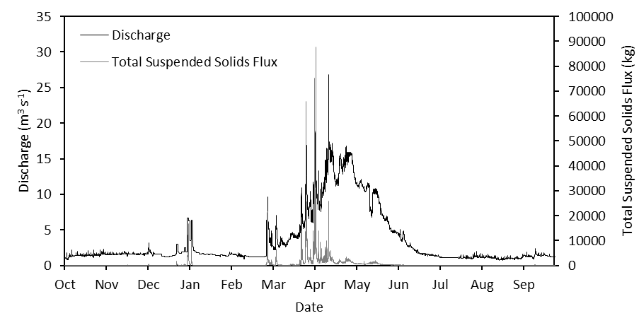
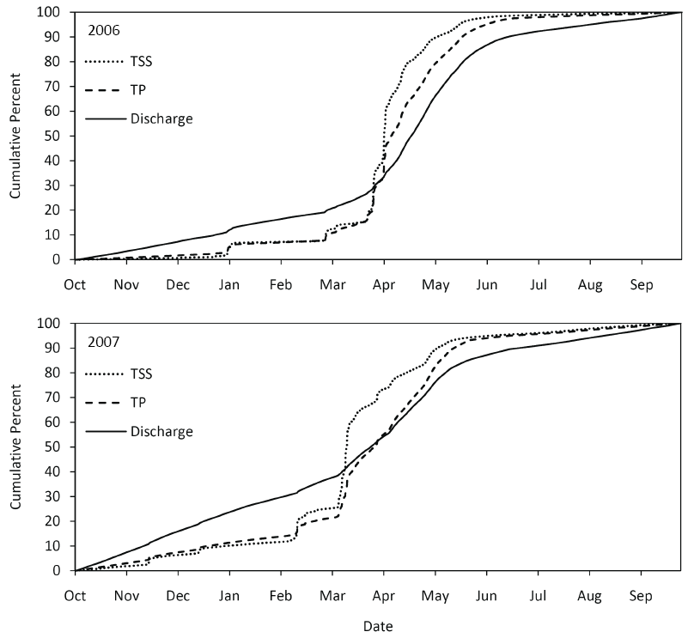
TP and TSS Flux 2006
TSS and TP from turbidity using surrogate relationships
~50-60% of the annual load occurs during one month of the year
Little Bear River Near Paradise, UT

Slide 50
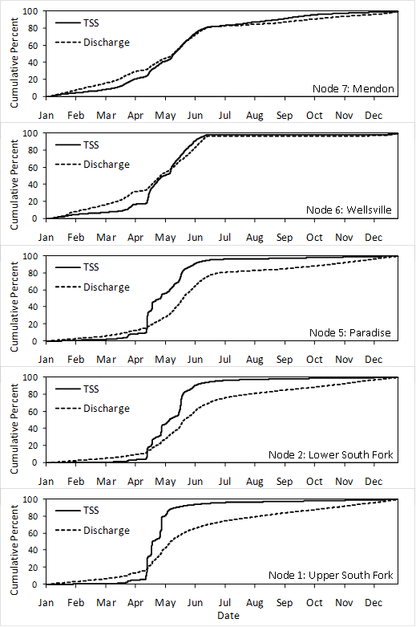
How do Natural Features and Human Activities Affect WQ Conditions?
Spatial distribution of total suspended solids fluxes in the Little Bear River for 2008. The areas of the node markers are proportional to the total suspended solids fluxes, which are expressed in metric tons.

Slide 51
Summary
It is difficult to understand or manage what we do not measure
Understanding for management requires:
Collecting data at a spatial and temporal frequency that is consistent with the processes we want to understand
AND we need data over times scales that will enable us to look at the longer term drivers
climate change
land use change
population growth
New technologies and monitoring techniques make this possible

Slide 52
Summary
High resolution (space/time) sensor data enables identification of trends and analysis of hydrologic and water quality behavior that could not be observed by more traditional water quality monitoring
…but often leaves us scratching our heads!
Large data volumes require cyberinfrastructure and expertise for managing and sharing the data

Slide 53
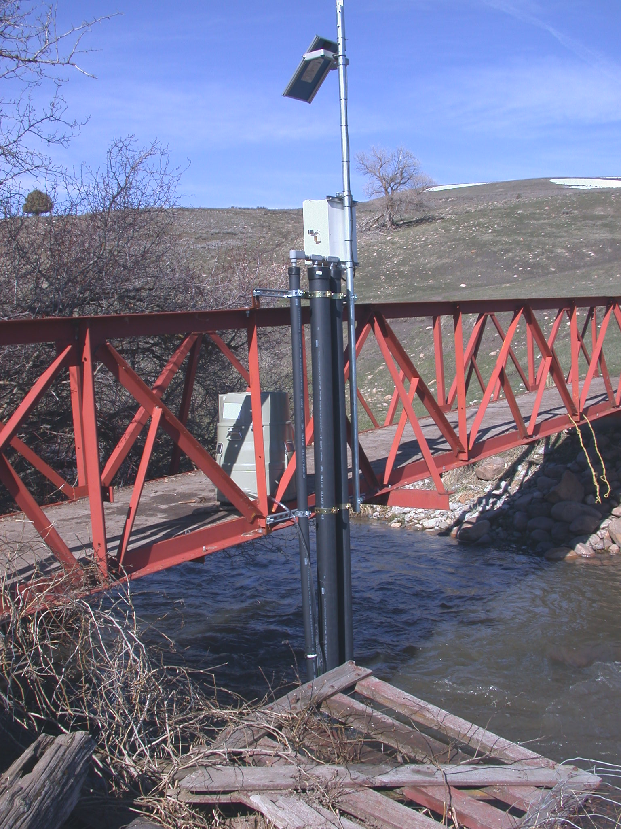




Questions?
Support:
EAR 0622374
CBET 0610075

